Slide 1
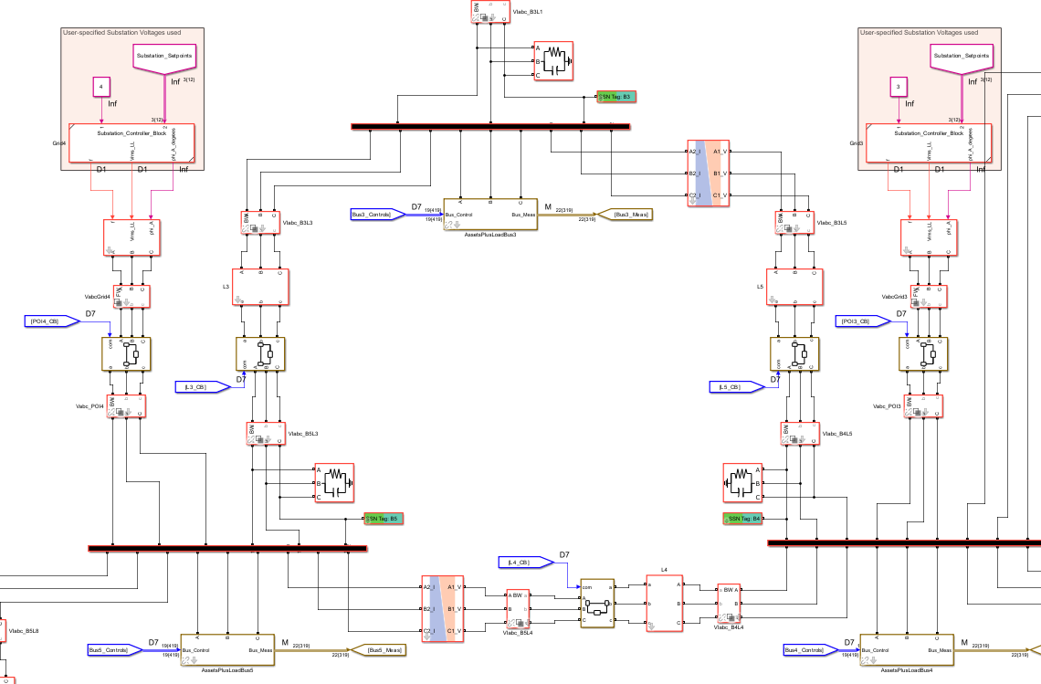
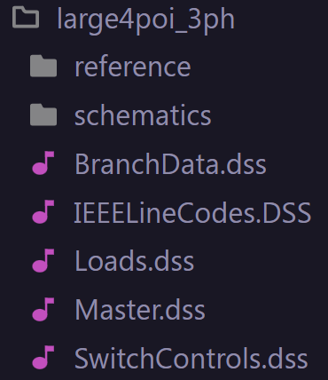
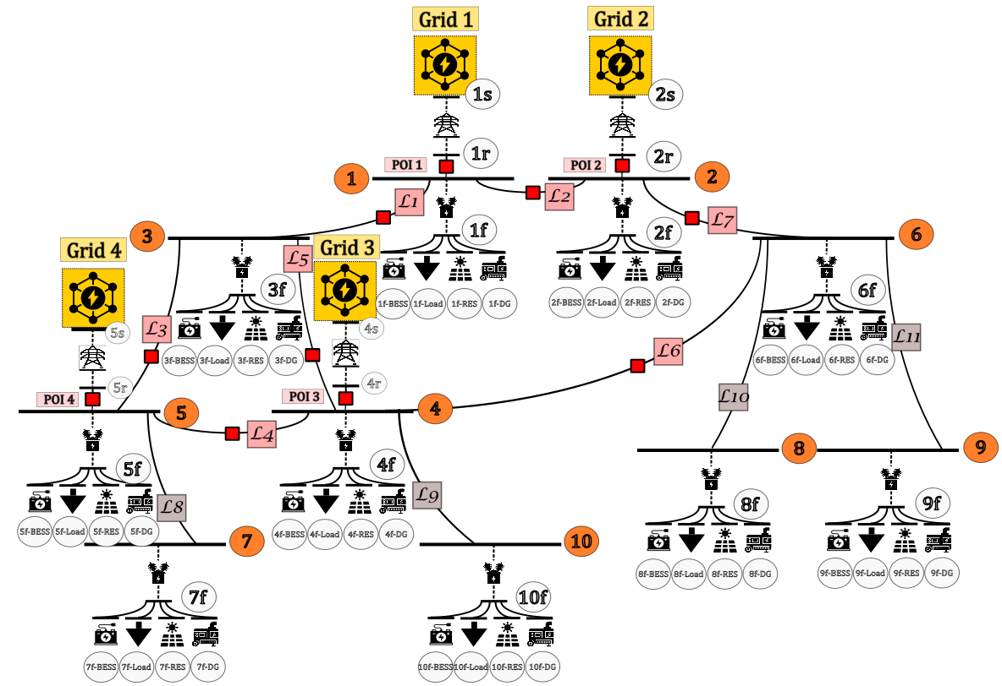
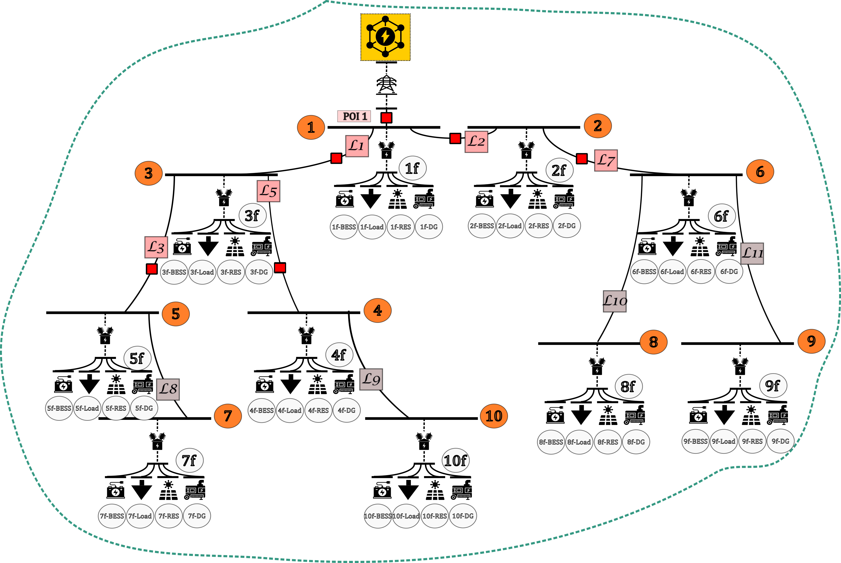


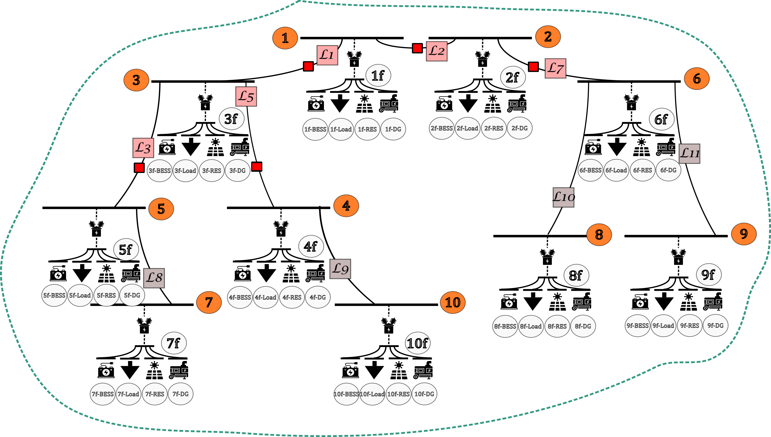
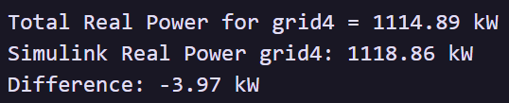
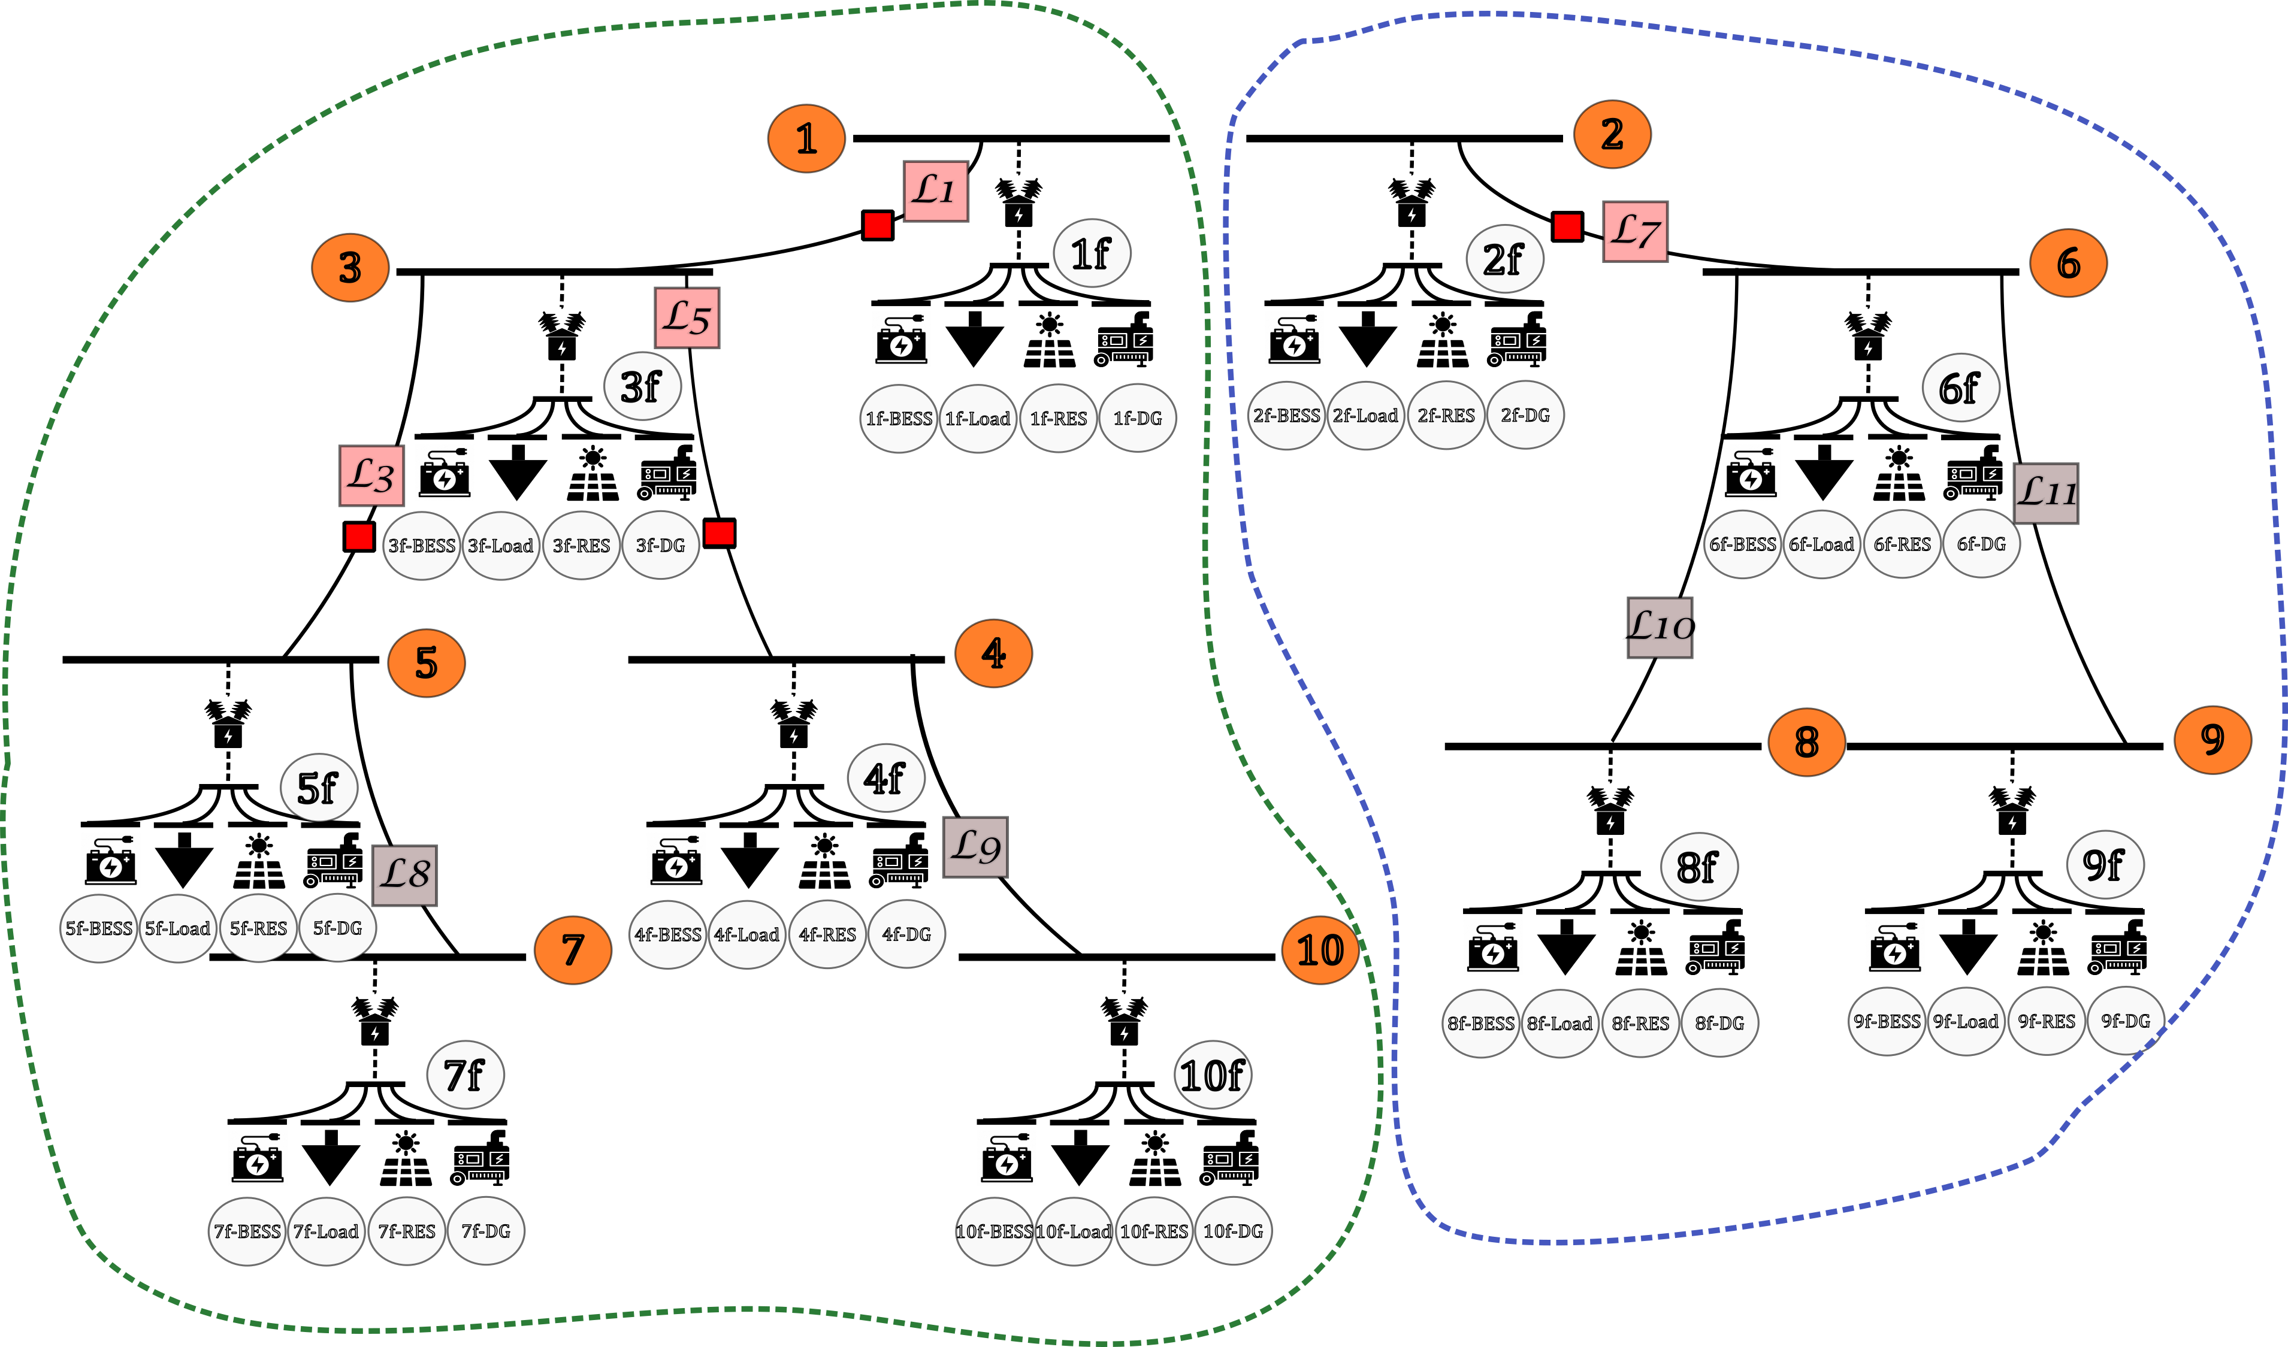

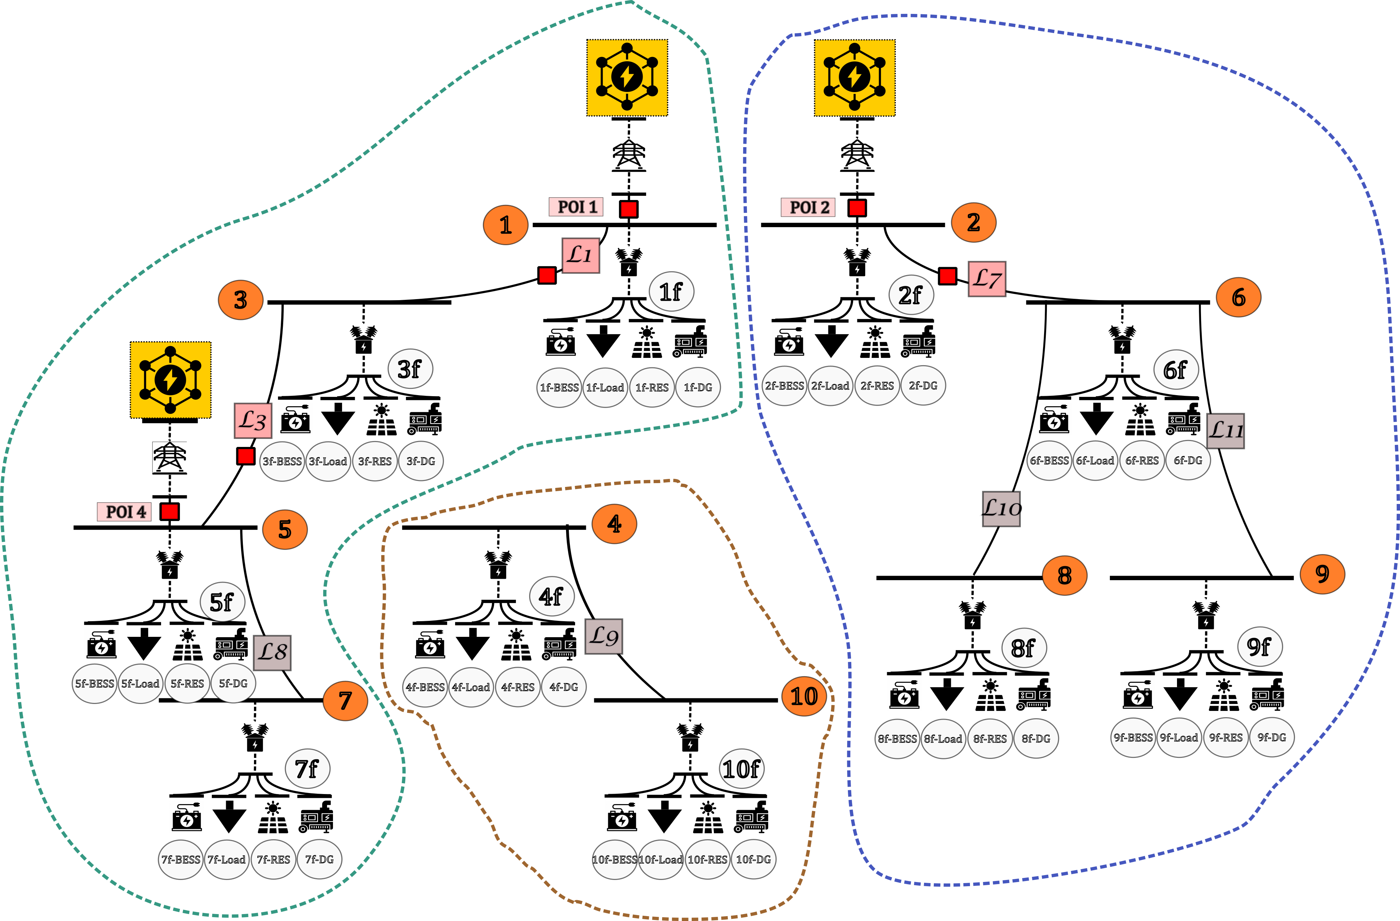
Zonal Autonomous Control (ZAC)
Aryan Ritwajeet Jha
Summer 2025 PhD Intern
Electrical Systems Team, GEVARC
PL: Hullas Sehgal
Buddy: Partha Mishra
Single Grid Connected Zone
GIVEN
Dynamic model of a power distribution system in Simulink
Single Grid Islanded Zone
TASK
Create a steady-state representation of the model in OpenDSS which can be used as part of a real-time MPC loop.
Model should be customizable to work for different scenarios (grid-connected or islanded), meshed or radial, and any substation and loading levels
OUTCOMES
Automated Simulink files for various grid scenarios; developed operation protocols.
OpenDSS files + Python scripts automatically read Simulink configuration and run powerflows which have been verified for multiple scenarios
Double Islanded Zones
Triple Zone Mixed Bag
Developed an OpenDSS ‘Plant Simulator’ model to be used in real-time control and optimization of a power distribution grid

